Slide 1
The New Normal For Investing
Presented by Morven Whyte, in partnership with
The seminar will start promptly at 2pm.

Slide 2
Agenda
Introduction to Redmayne Bentley
Ian Barr | Financial Services Manager | Walker Dunnett – 5 mins
Market Analysis & Strategy
Morven Whyte | Investment Manager | Redmayne Bentley – 15 mins
Questions from All
Fielded by Redmayne Bentley Investment Analyst Saul Fulda & Alli Hunter, Independent Financial Adviser at Walker Dunnett – 10 mins
Close - 2.30pm
Housekeeping
All participants will remain on mute for the duration of the seminar. Please ask questions using the chat function. The seminar will be recorded.

Slide 3
Resilience is Key
Coronavirus and its impact on global economies.

Slide 4
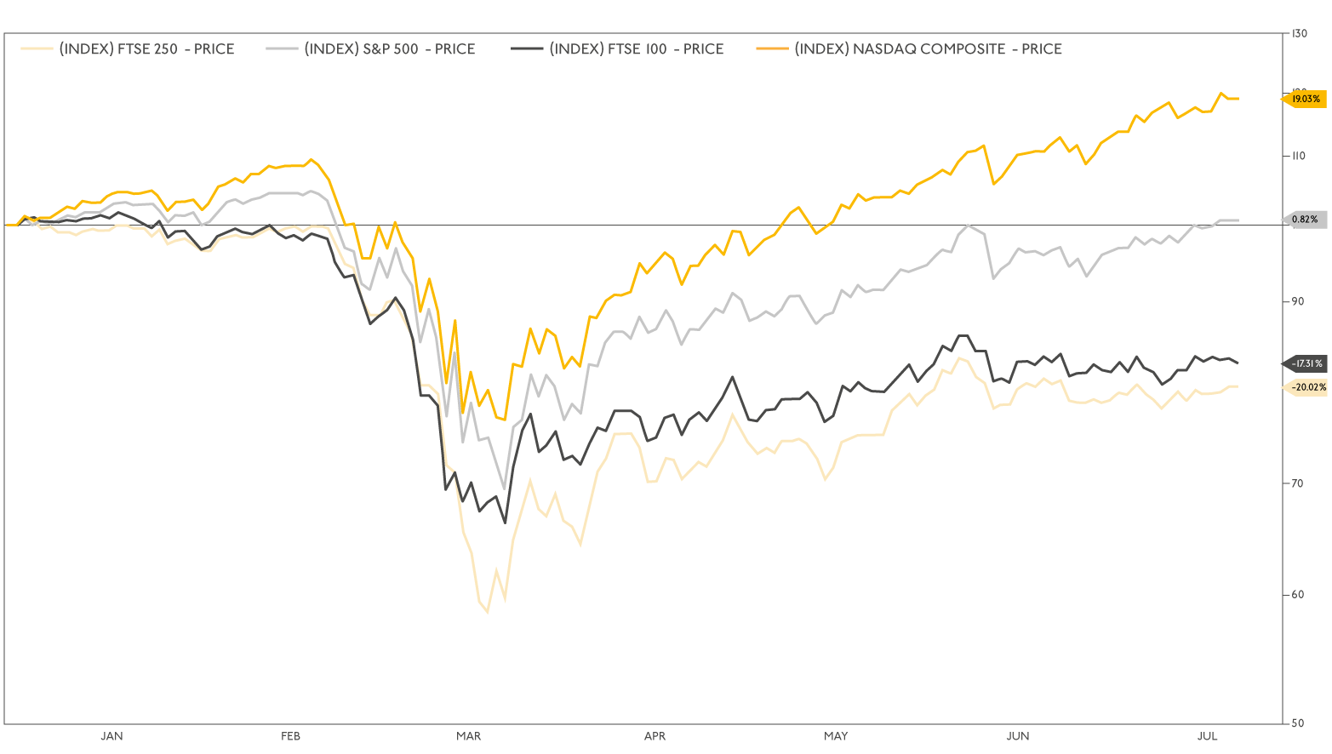
Performance of Major Indices
(Since 1st January 2020 to date)

Slide 5
Summer time reading!
‘An assault on both ignorance and pessimism’
THE TIMES

Slide 6
Total wealth created by All Listed
Global Stocks: 1990-2018
DIFFERENT TYPES OF GROWTH
NUMBER OF COMPANIES
60,289 companies
482 companies
208 companies
121 companies
Amazon.com
Apple
Coca Cola
Visa
Exxon
JP Morgan
The net collective contribution of 60,289 firms was the same as a one-month treasury bill
$22.3tn
$11.2tn
$11.2tn
Source: Baillie Gifford Bessembinder, H., Cheng, TF., Choi G. and John Wei, K.C. Do Global Stocks Outperform Treasury Bills? (July, 2019). The first author acknowledges financial support from Baillie Gifford & Co. The data includes 61,981 CRSP common stocks from January 1990 to December 2018. In cases where stocks list or delist within a calendar period the return is computed for the portion of the period where data is available. Due to dual share classes; dollar wealth is assessed at the company level. Beyond the best-performing 811 firms, an additional 23,094 firms (37.8%) of stocks created positive wealth over their lifetimes. The wealth creation of these stocks was just offset by the wealth destruction of the remaining 37,195 (60.9% of total) firms, so that the top 811 firms created the same wealth as the overall market.

Slide 7
United Nation Sustainability Goals

Slide 8
Risk Warning
This document is only for the intended recipient and should not be transmitted to, or relied upon, by any third party. Investments and income arising from them can fall in value and you may get back less than you invested. Past performance and forecasts are not reliable indicators of future results and performance.
The contents and weightings within the illustrations may be subject to change or substitution depending upon market conditions. Redmayne Bentley has taken every step to ensure the accuracy of the information and statistics in this presentation.

Slide 9
Any Questions?
Notes:
10) Any Questions Slide
Text box placed 65mm from top of slide and centred
Text is Georgia 80pt in RB Citrine
Background colour is RB Grey
There should be no requirement to edit this slide.

Slide 10
Thank you
Redmayne Bentley LLP | Authorised and Regulated by the Financial Conduct Authority || Members of the London Stock Exchange redmayne.co.uk
Notes:
11) Thank You Slide
Text box placed 65mm from top of slide and centred
Text is Georgia 80pt in RB Citrine
Background colour is RB Grey
Placement of the footer is fixed – please do not amend
There should be no requirement to edit this slide.

